Slide 1
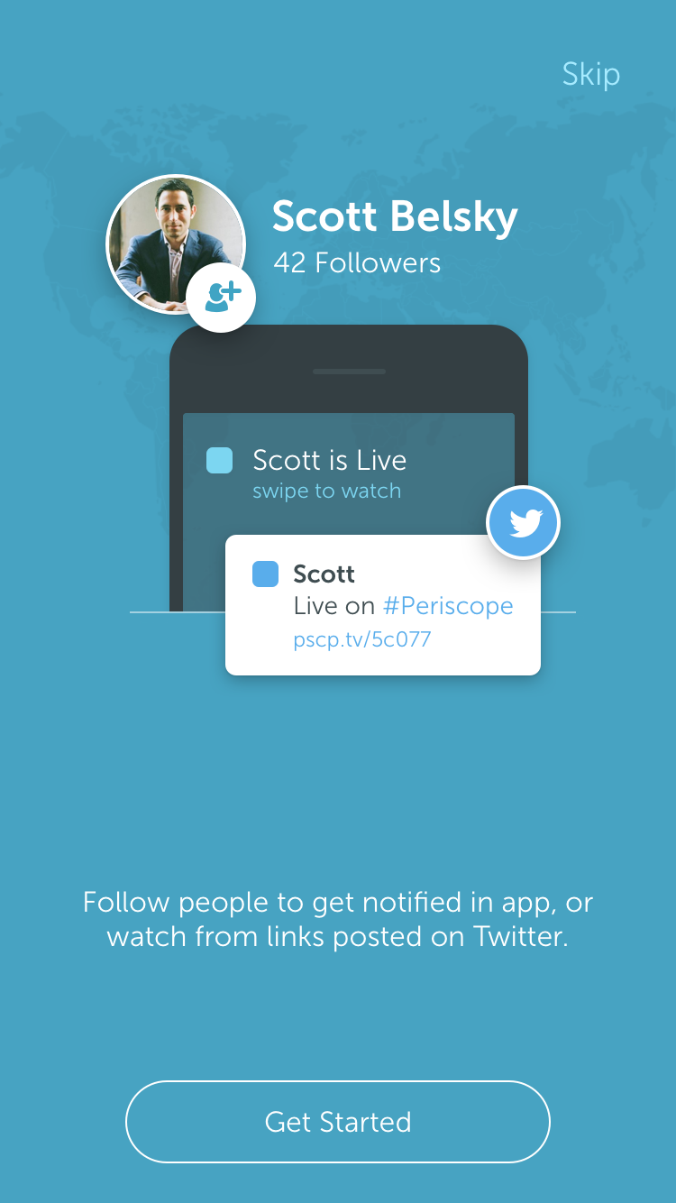
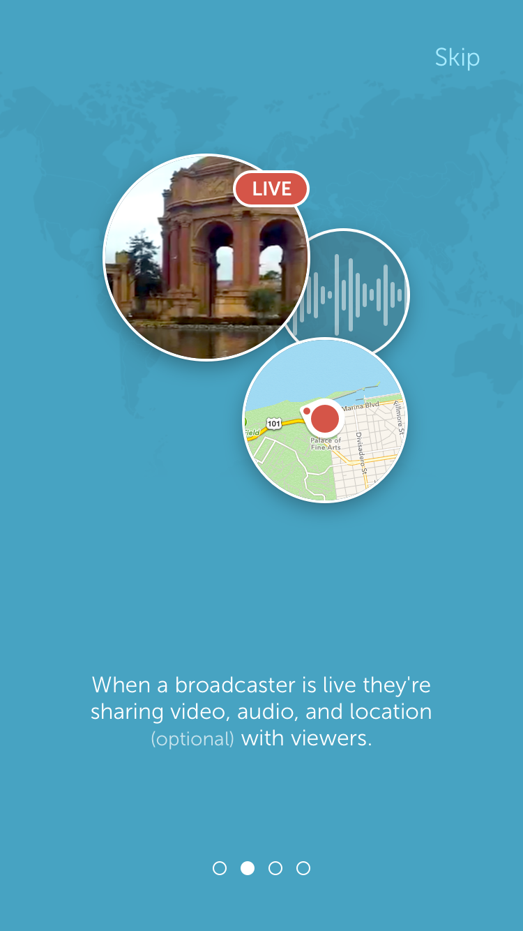
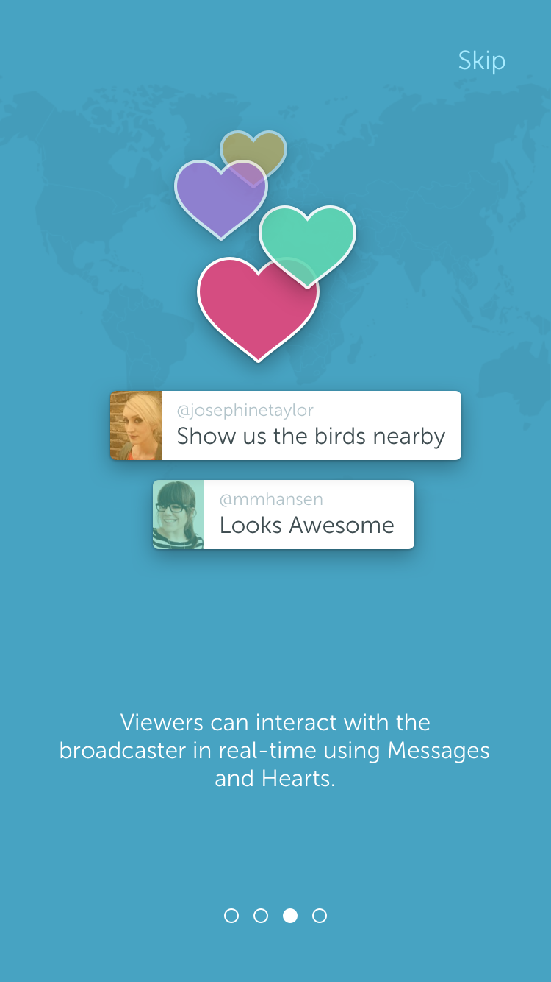
Periscope
Allows you to stream video from Android and iDevices with no other equipment needed
Video will stream directly to your Twitter account live
Followers can watch instantly
Read more about Periscope
Periscope.tv

Slide 2
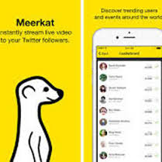
MeerKat
Also allows for streaming live to your Twitter feed via Google Play or Apple
Open to anyone 13 years and over
Can be more conversation-oriented
MeerKat

Slide 3
So which one?
MeerKat or Periscope

Slide 4
YouTube Live
Pros
Better quality (depending on equipment)
Webcam, iDevice, Vidiu , or camera
More common; most have the app
Cons
100 subscribers needed
Software must be downloaded
(Google Hangout, Flash Media Encoder)
Closer awareness of copyright
YouTube Live

Slide 5
Google Hangout
Google Hangouts is a communication platform developed by Google which includes instant messaging, video chat SMS, and VOIP feature (wikipedia).
You will need a Google account
See more on the Google Hangout webpage

Slide 6
SchoolTube
SchoolTube.com is the nation's largest K-12 moderated video sharing platform, specifically designed for students and educators –
exclusively endorsed by over twenty national education associations (http://www.schooltube.com/info/about)
Safety
Usually not blocked on school networks
$1000 per year for branded site and unlimited streaming capabilities

Slide 7
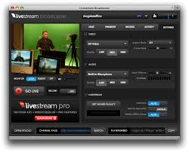
Other paid streaming services:
Ustream
GrandStadium
Playon Sports
MyLiveDistrict
Wowza
Streambox (free trial with limited hours)
Zoom (also offers free trials)

Slide 8
School Video News Live Video Web Streaming: What are your options
Live Stream School Events to Boot Community Outreach by Dr. Joe Mazza, Edutopia

